Slide 1
Raytheon Preternship
Project
Konrad Rozanski, Matt Huebner

Slide 2
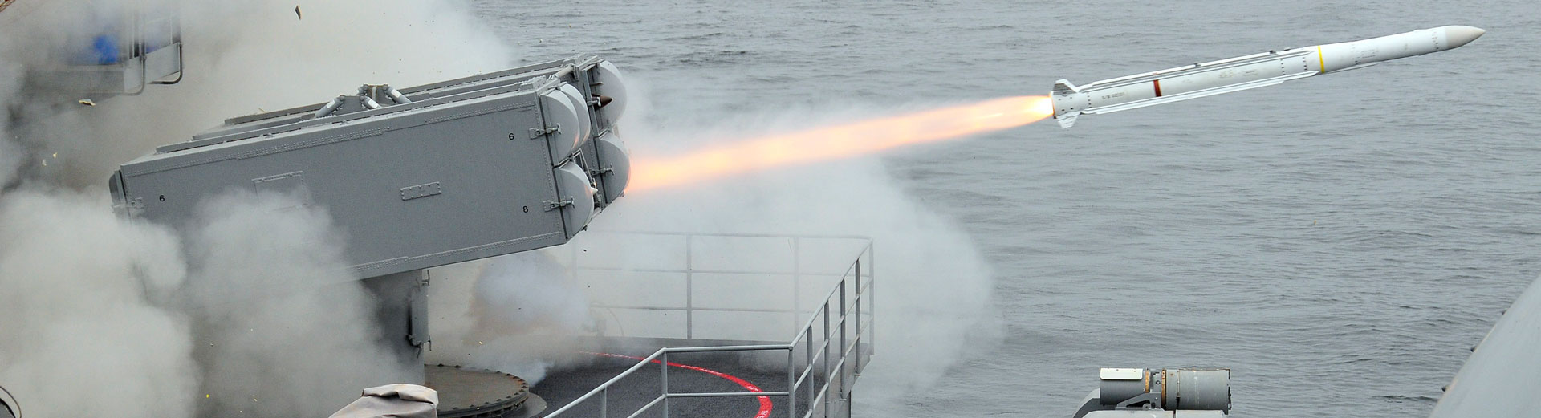
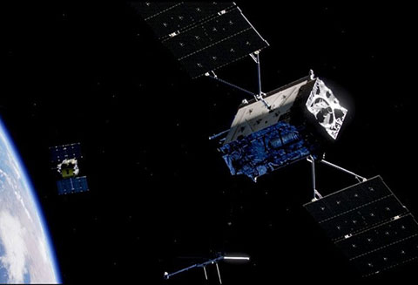
About Raytheon
Raytheon is an aerospace company focussing on satellite communications and military contracting.
A lot of work at Raytheon is focussed around telemetry, sensors, and signal processing.
For the military contracting, Raytheon develops missiles, radar systems, and other various defence systems.

Slide 3
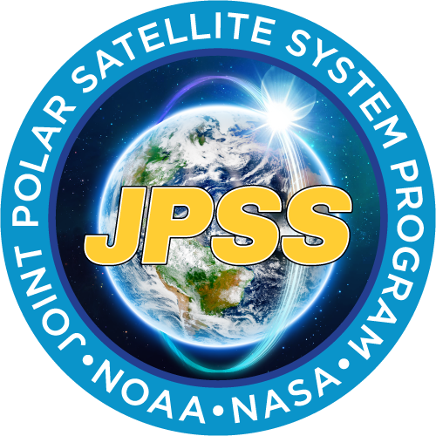
Our Mentor: John Mallinger
JPSS(Joint Polar Satellite System)
A project designed to monitor global environmental conditions and collect and disseminate data related to weather, atmosphere, and the oceans.
Essentially the project is to incorporate a large constellation of satellites with associated ground stations to receive data.
This project allows quick detection of incoming natural disasters.

Slide 4
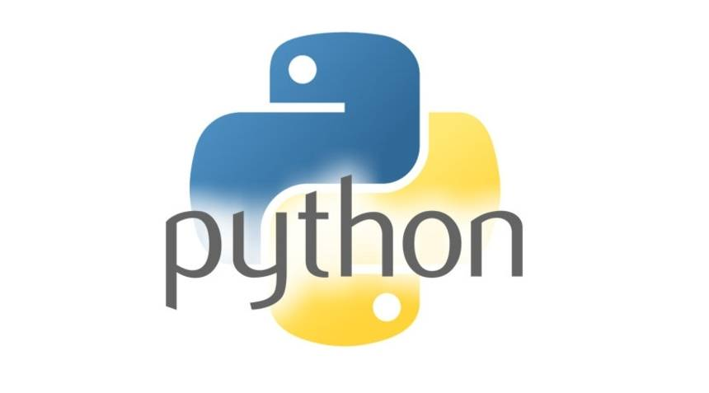
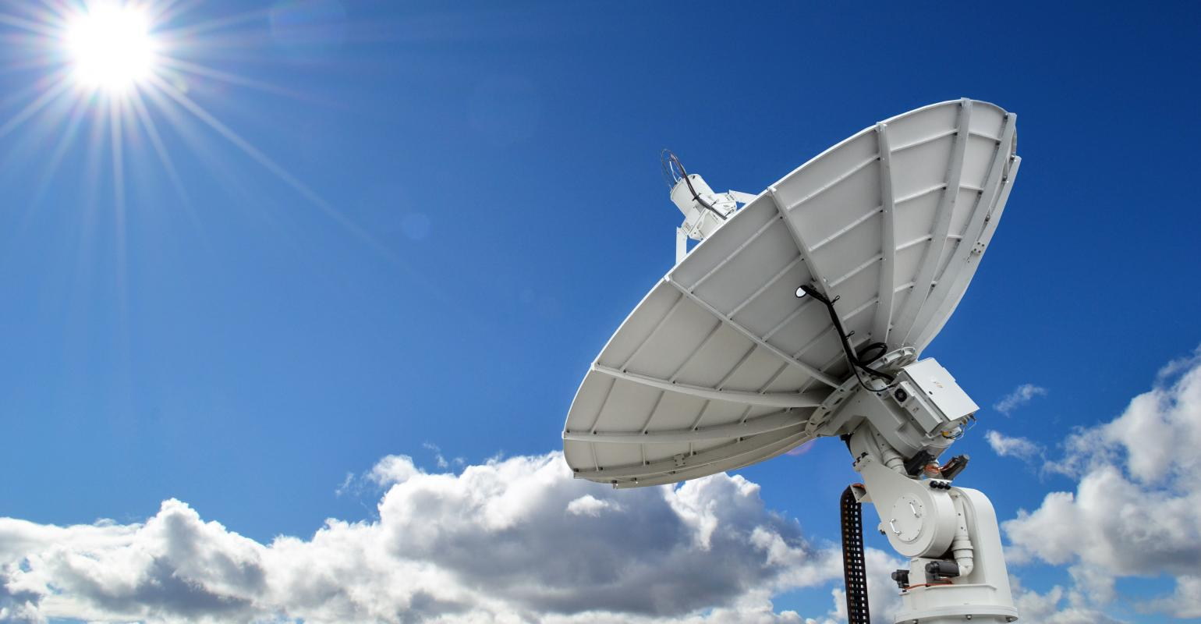
Our Project
Mr. Mallinger thought a project to determine ground station satellite specifications would allow us to better see the nature of his work.
Currently we are operating under a number of assumptions to make this work.
Inputs: altitude of satellite, latitude and longitude for ground station, and the satellites frequency
Output: length of antenna and diameter of the dish.

Slide 5
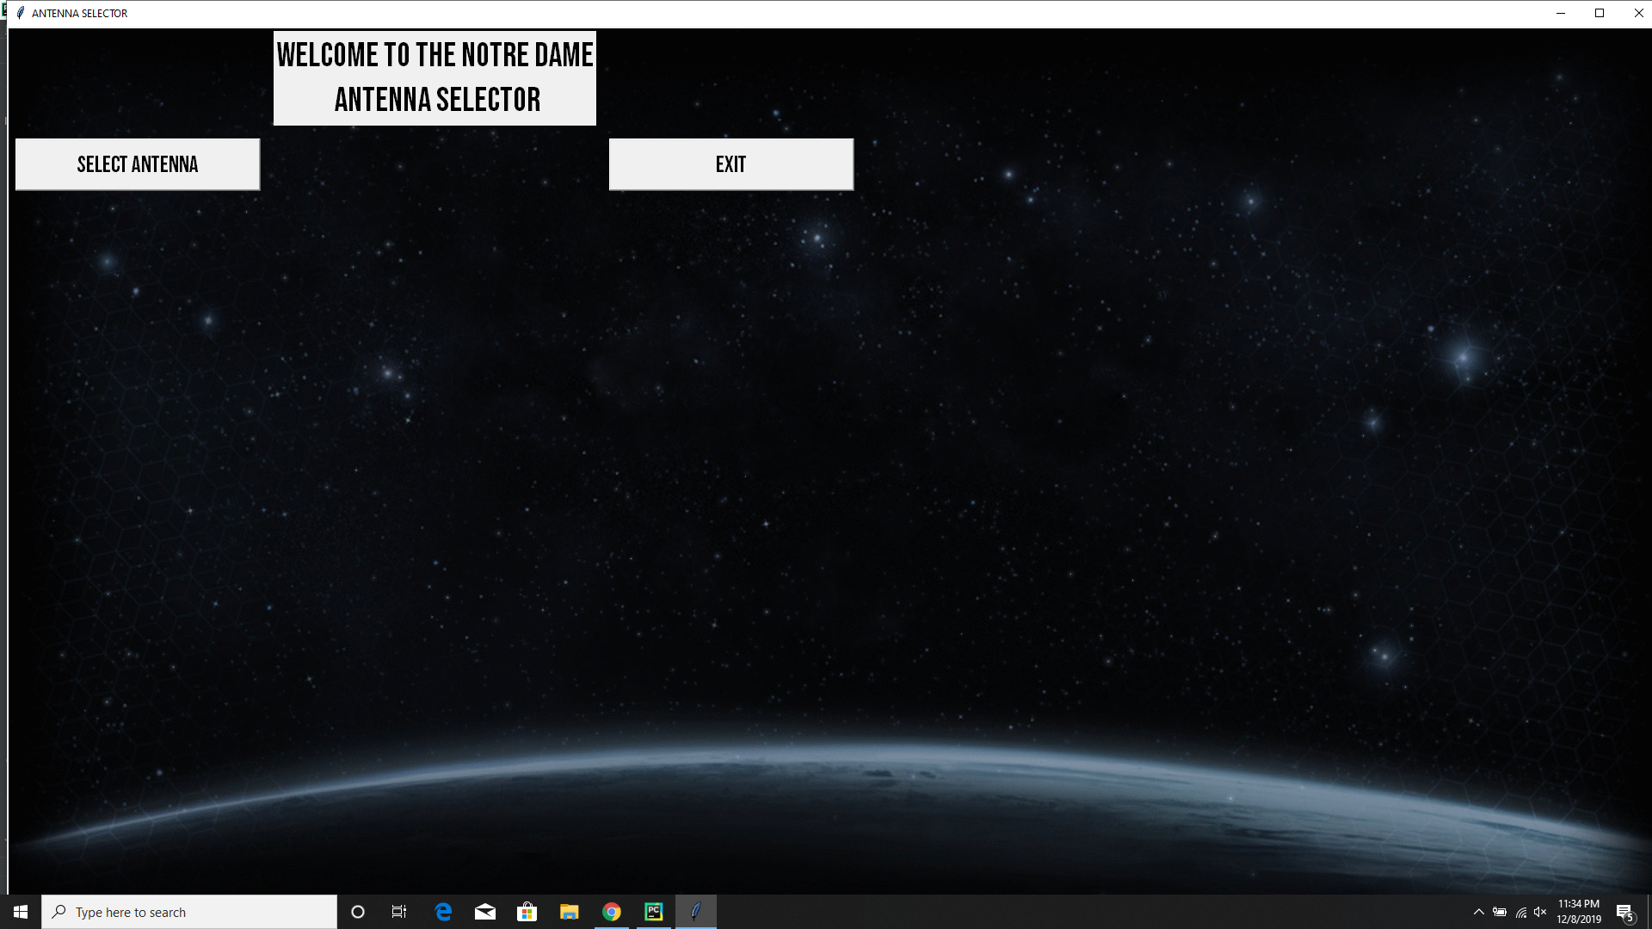
Screenshots

Slide 6
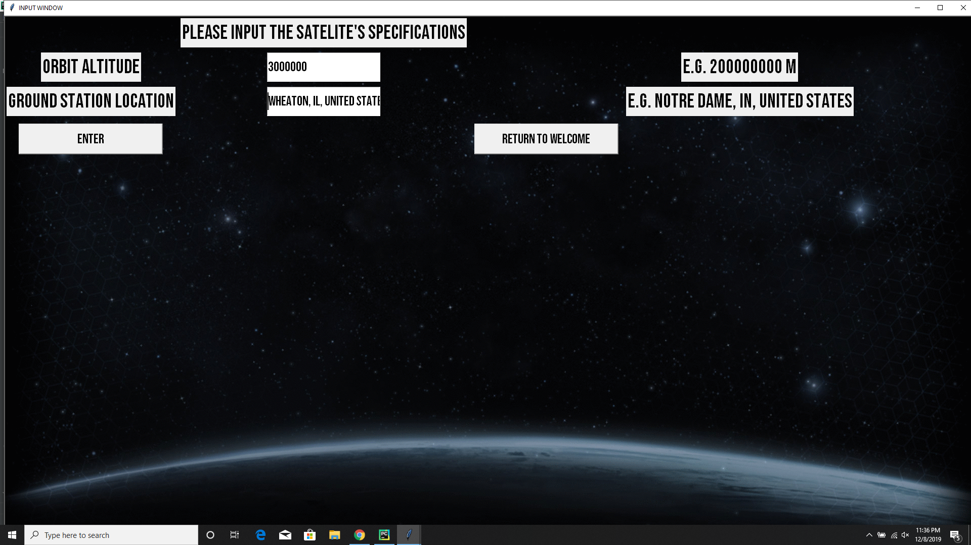
Screenshots

Slide 7
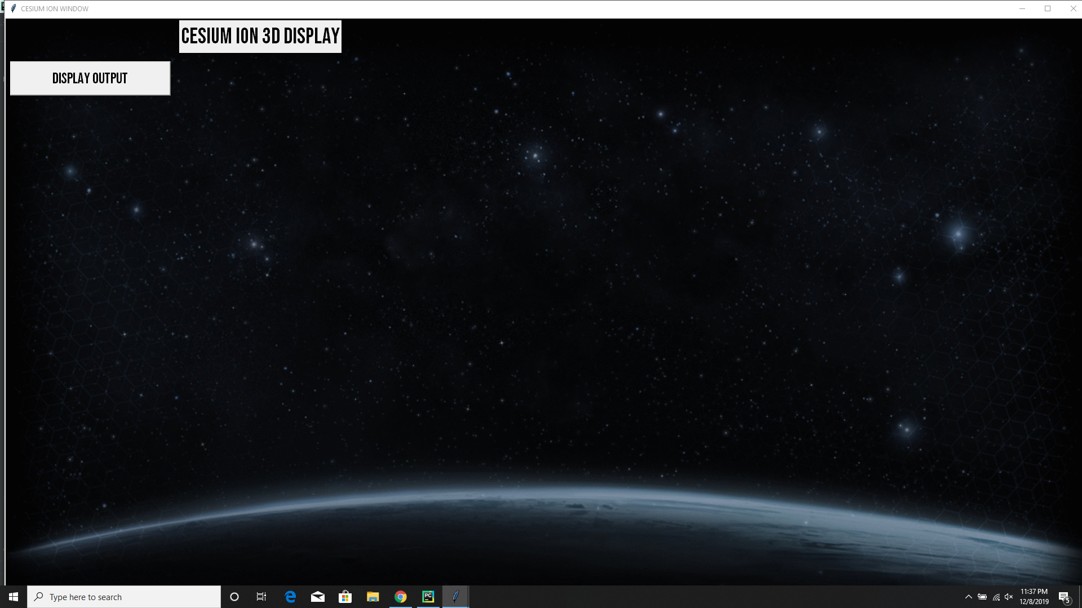

Slide 8
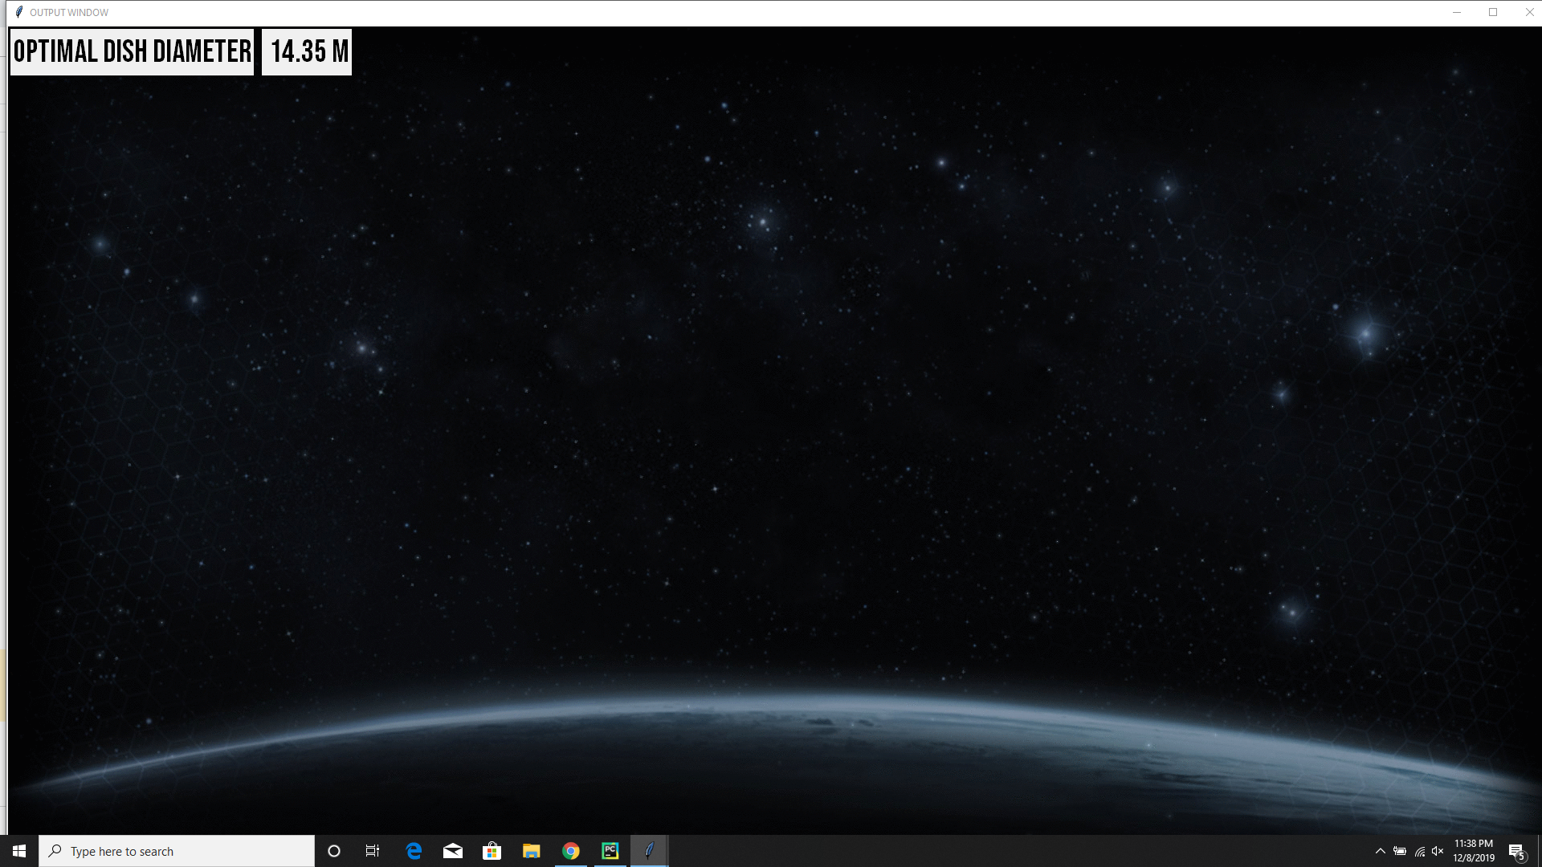

Slide 9
Class topics incorporated into the project
Object Oriented Programming
The GUI needs objects that wait for different events to work properly.
The computations class models
Utilizing 3rd Party Libraries
Parsing Input

Slide 10
Work Left to be done
We want to add more complex orbits to our project. This would allow us to remove the assumption that the orbit passes directly over the ground station.
Try to incorporate the weather for the longitude and latitude of the ground station as it would affect the signal.
Taking data from an API
Allow for multiple frequencies for the satellite to be inputted.
Improving the look of the GUI and the readability of the computations.
Implementing Cesium Ion REST API

